Slide 1
302CEM - G2 - logistics
Li Tung Leong 54777443
Ngai Yuen Ying 54827358
Lau Wut Shing 54777596
Leung Woon Hay Ryan 55441017

Slide 2
Video of presenation
https://github.com/pinionli/ITB_302CEM_G2_Logistics

Slide 3
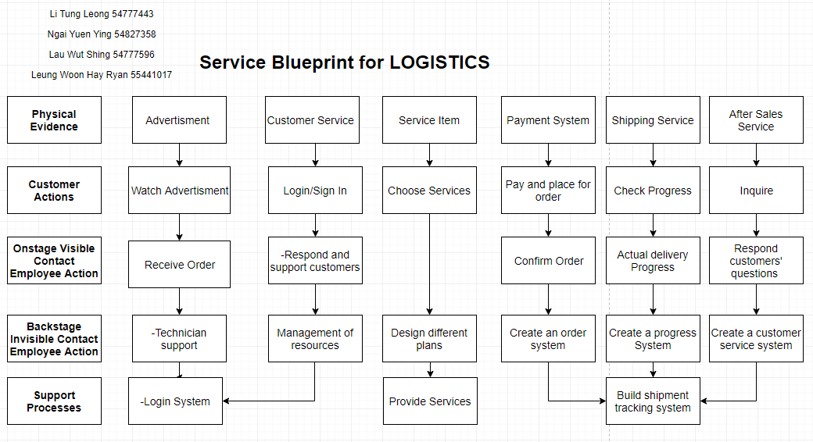
Service blueprint

Slide 4
Data information (Manufactor x Logistics)
Name | Data type | Description
exp_key | int | exp_key
item_no | varchar | The item number
expected_shipment_date | date | The expected shipment date
qty | int | The number of item quantity
price_per_item | int | The price per item
manufacturer_id | varchar | manufacturer id
retailer_id | varchar | retailer id
status | varchar | the current status of shipping

Slide 5
Data information (Online Retailer x Logistics)
Name | Data type | Description
exp_key | int | exp_key
item_no | varchar | The item number
ship_to_address | varchar | The address of shipping
qty | int | The number of item quantity
expected_shipment_date | date | expected shipment date
logistic_id | varchar | logistic_id
retailer_id | varchar | retailer_id
status | varchar | the current status of shipping

Slide 6
Agile project template

Slide 7
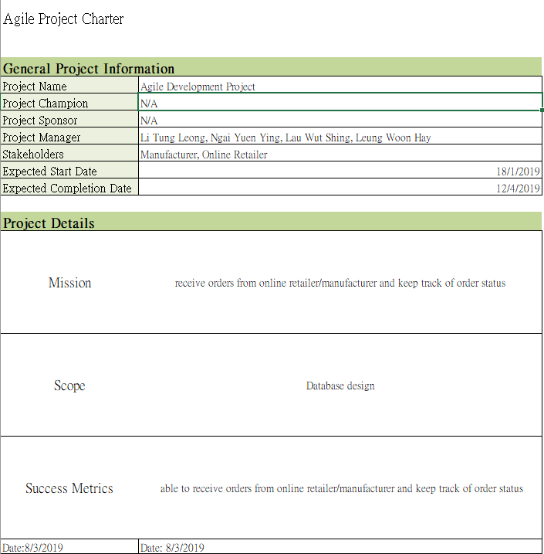

Slide 8
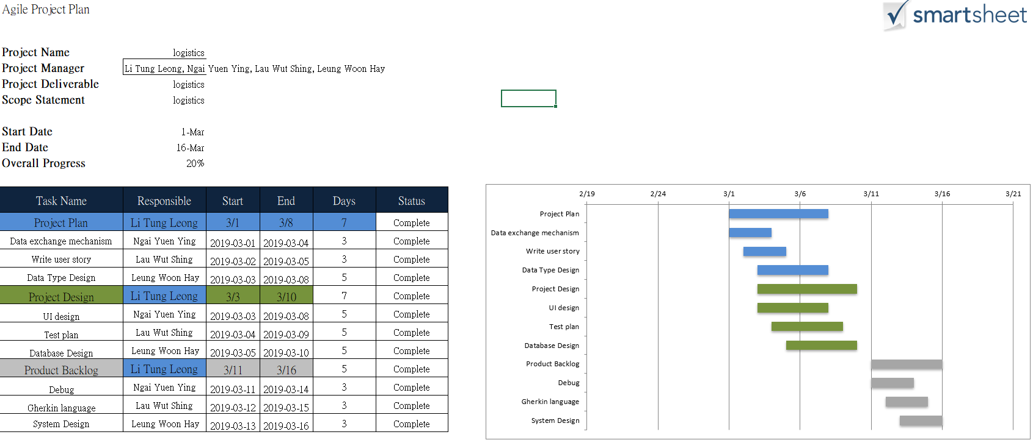

Slide 9
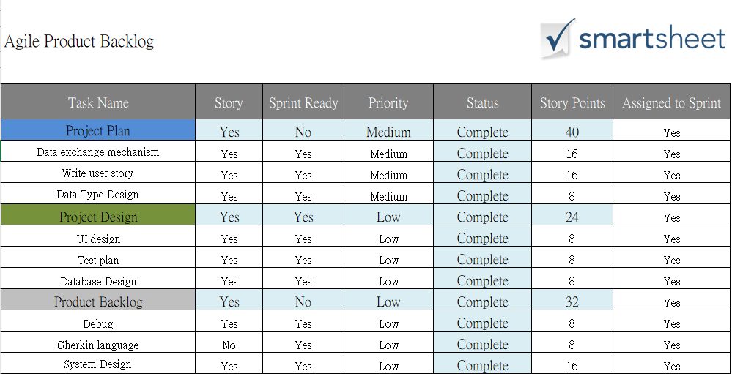

Slide 10
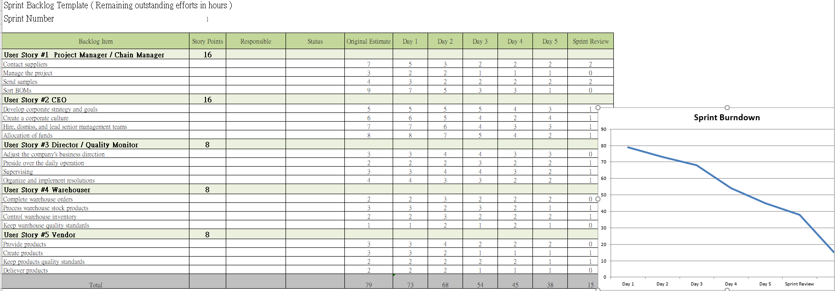

Slide 11
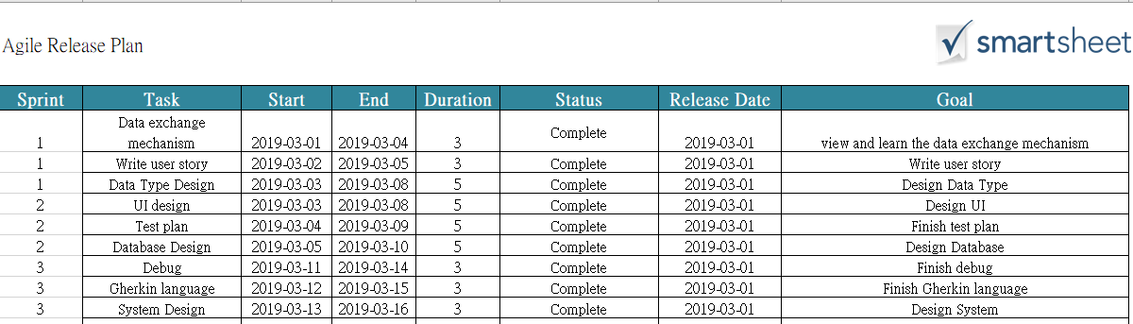

Slide 12
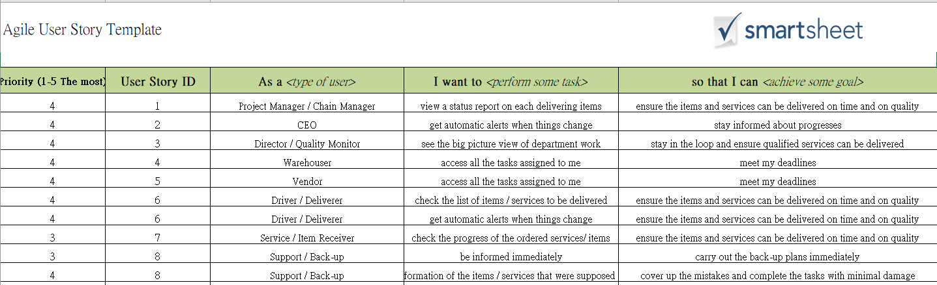
User stories

Slide 13
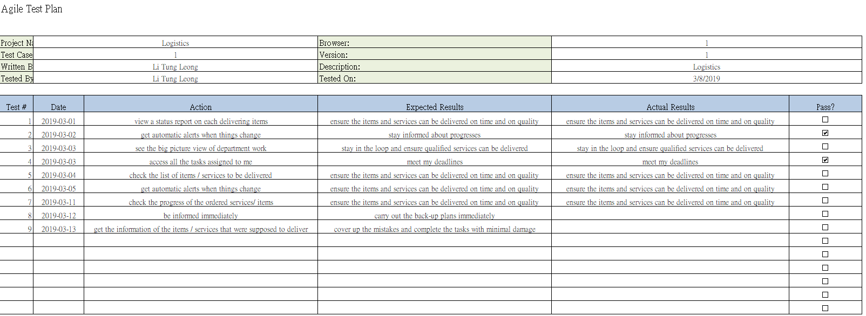

Slide 14

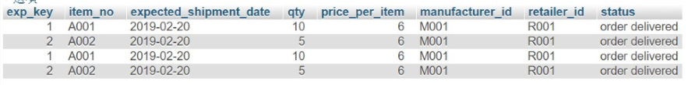
Data interface layout
Retailer order data
Manufacturer order data

Slide 15
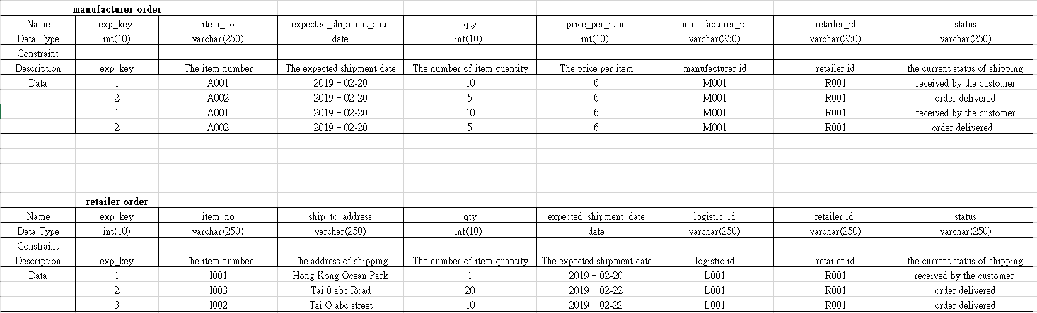

Slide 16
Github link
https://github.com/pinionli/ITB_302CEM_G2_Logistics

